Slide 1


SDP
LECTURE
The State Design Pattern
Software Design Patterns
Diploma in IT
Year 2 (2024/25), Semester 3
3.1
Notes:
Hi everyone! In our first lesson this week, we are going to introduce you to your first design pattern. When we talked about state machines last week, we did not cover how we would actually code one. That’s what we are going to do today, with the State design pattern. I bet you’re all excited.

Slide 2
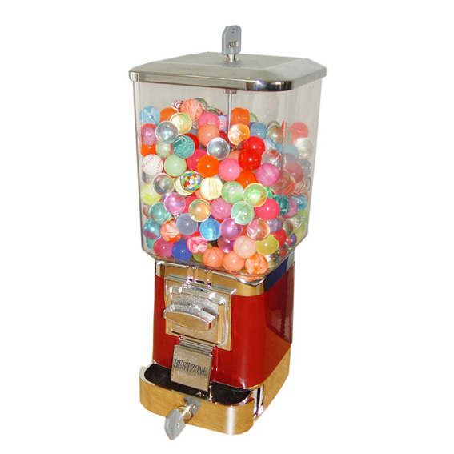
Example Problem – Toy Dispenser
High-tech C#-based Toy Capsule Dispenser!
Notes:
We will be using an example of a toy capsule dispenser, also known as “gachapon”. You’ve probably seen these things in some shopping centres. It’d be full of capsules with neat toys like little Pokemon or Minion figurines or slime or something. You’d put in a coin, turn a crank, and then one of those capsules will drop out of the slot. It’s like toy gambling for kids. Anyway, let’s ty to implement a C# version of this.
Image source:
http://image.made-in-china.com/6f3j00QvMaeBThIEot/Toy-Capsule-vending-Machine.jpg

Slide 3
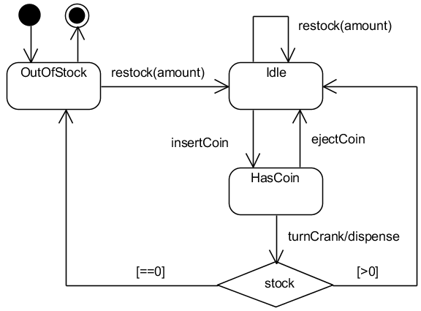
State Machine
Lecture 3.1 Slide 3
Notes:
Here is the State Machine diagram that represents our toy capsule dispenser. We see that when the machine is first created, it is in the || OutOfStock state, which represents an empty machine. We can || restock the machine with an amount, representing the number of capsules we put in, and we can assume that amount is a positive number. Once the machine is not empty, it goes to || the Idle state. When Idle, we can || restock the machine before it runs out of stock. A customer can also buy a capsule by || inserting a $1 coin into the slot, whereupon the machine goes to the || HasCoin state. Here, the customer can change their mind and || eject their coin, returning the machine back to the Idle state. Alternatively, they can || turn the crank to dispense the toy. Once that happens, we come to a choice node that asks if the stock left is greater than zero. If it || is, then we return to the Idle state. But if the toy we dispensed was the || last one in the machine, then we’re out of stock and go to the OutOfStock state. Pretty straightforward, right?
Note that all toys cost exactly one $1 coin. The machine does not accept any other types of currency.
Examine the diagram to ensure you understand the life cycle of the Toy Capsule Dispenser as it is commissioned until it is de-commissioned.

Slide 4
Implementation Steps
Identify states
Idle, HasCoin, OutOfStock
Identify call triggers
insertCoin, ejectCoin, turnCrank, restock
Identify actions
dispense
Write code!
Lecture 3.1 Slide 4
Notes:
Now that we have produced the state machine for our dispenser, it is time to implement it. Loosely speaking, there are 4 steps to implementing a state machine. First, we should || identify the states, and verify that they are suitable states. In our case, we have the || Idle, HasCoin and OutOfStock states, and with a little thought we can verify that these are suitable states since the machine acts differently in each state, and the machine is in each state for some time. Second, we should || identify the call triggers which will correspond to some operations in our class. In our example, we have the || insertCoin, ejectCoin, turnCrank and restock call triggers. Third, we should || identify the actions, which will correspond to some operation or other lines of code in affected objects. In this case, we have || one action called dispense, which turns out to be an operation in our ToyMachine class. And the final step? We || write code!

Slide 5
1st Implementation Attempt
class ToyMachine {
const int OUT_OF_STOCK = 0;
const int IDLE = 1;
const int HAS_COIN = 2;
private int state = OUT_OF_STOCK;
private int stock = 0;
// Not reflected in state machine
public ToyMachine(int amount) {
stock = amount;
if (stock > 0)
state = IDLE;
}
Lecture 3.1 Slide 5
Notes:
And that’s the big question, isn’t it? How do we write code to implement our state machine? Well, since we have a number of states and we can do different things depending on what state we are in, we need some way to keep track of our current state. An intuitive way of doing this is to have an attribute called state of type int, and we just represent each state by a unique integer, and we can do this effectively using constant values. Let’s try this technique in our first implementation attempt of our ToyMachine class.
In our code, we define || 3 const int values to represent our 3 possible states, assigning OUT_OF_STOCK to 0, IDLE to 1 and HAS_COIN to 2. We then define a private int attribute || called state that records our current state, which we initialize to the value OUT_OF_STOCK. We could also do this using an enumerated type, but this works.
Additionally, we have a private attribute || stock that keeps track of the number of capsules in the machine. Now we can write a slightly better || constructor for our ToyMachine class that takes an amount as its parameter, so this allows us to create a non-empty machine at the start. If the machine starts off empty, then it defaults to OUT_OF_STOCK state, but if it is not empty, it starts off in IDLE state.

Slide 6
insertCoin()
public void insertCoin() {
if (state == OUT_OF_STOCK)
Console.WriteLine(“You can’t insert coin,
machine is out of stock!”);
else if (state == IDLE) {
Console.WriteLine(“You inserted a coin.”);
state = HAS_COIN;
}
else if (state == HAS_COIN)
Console.WriteLine(“You can’t insert another
coin!”);
}
Lecture 3.1 Slide 6
Notes:
So that handles the states. Next, we have to handle the triggers, and for each trigger, our machine acts differently depending on its current state. So what we can do is create an operation for each trigger, and handle each possible state separately using if-else statements. Here is our insertCoin() operation, and since we have 3 different possible states, we need to use if-else to handle all 3 states. If we are in || OUT_OF_STOCK state, insertCoin() should produce an error message; if we are || IDLE, then it should go to the HAS_COIN state; and if we are already in || HAS_COIN, it should produce a different error message.

Slide 7
ejectCoin()
public void ejectCoin() {
if (state == OUT_OF_STOCK)
Console.WriteLine(“You can’t eject your coin,
you haven’t inserted one yet!”);
else if (state == IDLE)
Console.WriteLine( “You can’t eject coin,
you haven’t inserted one yet!”);
else if (state == HAS_COIN) {
Console.WriteLine(“Coin returned.”);
state = IDLE;
}
}
Lecture 3.1 Slide 7
Notes:
We can do the same thing for ejectCoin()…

Slide 8
turnCrank()
public void turnCrank() {
if (state == OUT_OF_STOCK)
Console.WriteLine(“You can’t turn the crank,
the machine is empty.”);
else if (state == IDLE)
Console.WriteLine(“You can’t turn the crank,
you haven’t inserted a coin yet!”);
else if (state == HAS_COIN) {
dispense(); // reduces stock by one
Console.WriteLine(“Toy dispensed. Enjoy!”);
if (stock > 0) state = IDLE;
else state = OUT_OF_STOCK;
}
}
Lecture 3.1 Slide 8
Notes:
…And also for turnCrank(). So in each operation corresponding to a trigger, we would need to carefully code the logic of the state machine, including state changes and actions. In this case, if we are in || HAS_COIN state and turnCrank() is called, we execute the dispense() local function, then check the value of stock and go to either the IDLE or OUT_OF_STOCK state depending on the value.

Slide 9
restock(amount)
public void restock(int amount) {
if (state == OUT_OF_STOCK) {
stock = amount;
if (stock > 0) state = IDLE;
}
else if (state == IDLE)
stock += amount;
else if (state == HAS_COIN) {
Console.WriteLine(“You can’t restock while a
customer is buying a toy!”);
}
}
Lecture 3.1 Slide 9
Notes:
And here is the code for restock(). Note that there are 4 methods because we have identified 4 call triggers. Each method would need to check for all the states, and since we have 3 states, we need 4 * 3 = 12 separate blocks of code in a bunch of if-else statements to handle all the logic. This seems like quite a bit of code to write, but we were careful and we did it. The code works! Mission accomplished!

Slide 10
New Requirement (as usual…)
Toy company wants to make the machines more attractive
10% of the time, the customer gets two toys instead of one!
How do we modify our state machine to handle this new requirement?
Lecture 3.1 Slide 10
Notes:
Yeah, right, life’s just that perfect. Back to work, everyone, we have a new requirement! Now toy company wants to make the machines more attractive by making it such that each time a customer buys a capsule, they have a 10% chance of getting a second capsule, absolutely free! Such fun! Much wow!
OK, so now we need to || modify our state machine to handle this new requirement. Let’s see what changes have to be made.

Slide 11
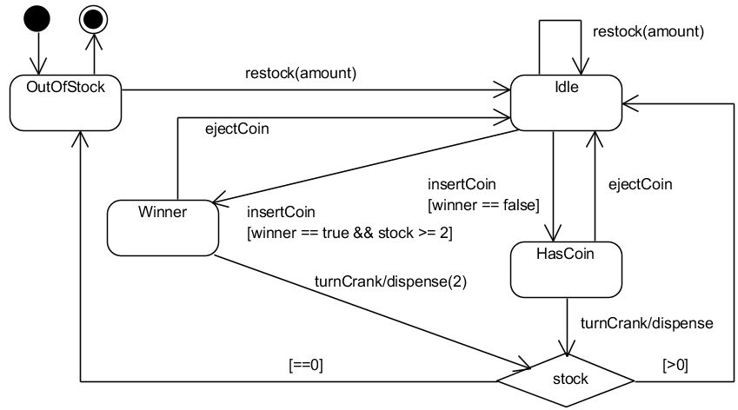
New State Machine
Lecture 3.1 Slide 11
Notes:
Here is one way we can implement the new scheme. In this version, we determine whether the customer is a winner when they insert a coin, and this is reflected using the Boolean value “winner”. So there are now 2 possible transitions from Idle when insertCoin is called. If the || 10% chance occurs and we have at least 2 capsules remaining, then transition to a new Winner state. From the Winner state, the customer can || turn the crank and receive 2 capsules, happy day! Alternatively, you may miss the 10% chance, so || winner becomes false and we transition to the old HasCoin state. In this state, turning the crank will dispense only || one capsule as usual. Incidentally, it is important not to indicate to the customer whether or not they are a winner once the coin is inserted, otherwise they can game the system by inserting and ejecting a coin until they win!

Slide 12
What Changes?
class ToyMachine {
const int OUT_OF_STOCK = 0;
const int IDLE = 1;
const int HAS_COIN = 2;
const int WINNER = 3;
// new code to handle WINNER state in all of
// these methods!
public void insertCoin() { … }
public void ejectCoin() { … }
public void turnCrank() { … }
public void restock(int amount) { … }
}
Lecture 3.1 Slide 12
Notes:
Right, so how does this affect our code? Well, we now need a new WINNER state, which is straightforward enough. What else do we need to change? Potentially, we will need to modify every single method to handle the WINNER state. insertCoin() needs to handle generating a winner and move to a different state depending on whether the customer won; ejectCoin() has to handle the new WINNER state, and turnCrank() will dispense different numbers of capsules depending on what state the machine is in. That’s a lot of code to modify, and the way we wrote this code, we don’t have much choice but to look at every method whenever a change is made to the state machine.

Slide 13
Issues with Current Implementation
Whenever a new state has to be added or removed, all methods that cause transitions are affected
Lots of “if” statements that are hard to maintain
Lecture 3.1 Slide 13
Notes:
Now we see some issues with our current implementation. Whenever our state machine is modified, whether it is adding, modifying or removing a new state or transition, all methods are potentially affected. And our current use of lots of “if” statements to handle each state in each method is really clumsy and hard to maintain. There has got to be a better way.

Slide 14
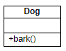
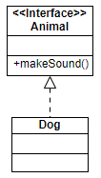
Let’s Apply a Design Principle
Principle: “Program to an interface, not an implementation”
Note: “interface” means “supertype”
Coding to an implementation:
Dog d = new Dog();
d.bark();
Coding to an interface:
Animal a = getAnimal();
a.makeSound();
Lecture 3.1 Slide 14
Notes:
So, what do we do? Well, over the years, as people learn more about object-oriented programming, we have discovered several design principles that help us make good OO programs. One such principle is: || Program to an interface, not an implementation. What does this mean?
Coding to an || implementation means that we have an actual object, and just call methods belonging to that object. For example, when we create an object || d of class Dog, we have a Dog object and this object can execute methods of the Dog class, such as || bark(). This is pretty much the default way that we code OO programs.
When we code to || an interface, we don’t create an object. Instead, we have an interface, which is an empty shell with methods that do not have a body. The interface cannot do anything by itself, it’s just a template. For example, we could have an || Animal interface that has the method makeSound(), and the Dog class implements Animal. This means that the Dog class must override the makeSound() method, and for Dogs, its makeSound() method would be to bark. If a Cat class also implements Animal, then its makeSound() would be to meow, and so on. To use this, we would instantiate an || Animal object a, and in this case, getAnimal() could return any object that implements the Animal interface. Then, we could just call || a.makeSound(), and depending on what is the type of Animal that was assigned to a, it would call the corresponding version of makeSound(). So if a was a Dog, it would bark, and if it is a Cat, it would meow. Isn’t that awesome?

Slide 15
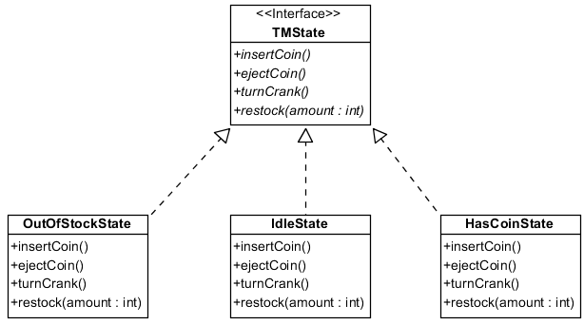
A Better Solution…
Let’s create an interface for all states to implement:
Lecture 3.1 Slide 15
Notes:
Given this design principle, here is a better solution for implementing our state machine. For each state, we are going to create a new class, so OutOfStockState, IdleState and HasCoinState are all separate classes. We will handle the WinnerState later. In addition, we will create an interface that all toy machine states must implement called TMState. In that interface, we define all the required abstract methods that correspond to the call triggers, namely insertCoin(), ejectCoin(), turnCrank() and restock().
Once we do this, we can implement the logic of what happens within the classes themselves. For example, OutOfStockState will contain the code that will run when the machine is out of stock and each of the triggers are called, namely insertcoin(), ejectCoin(), turnCrank() and restock(). So now, instead of using an integer to represent the state of the toy machine, we can use an object of the correct type instead. Let’s see this in action.

Slide 16
TMState Interface
interface TMState {
void insertCoin();
void ejectCoin();
void turnCrank();
void restock(int amount);
}
Lecture 3.1 Slide 16
Notes:
Here is the code for the TMState interface class, which is the interface for all toy machine states. Super simple.

Slide 17
IdleState Class
class IdleState: TMState {
private ToyMachine myMachine;
public IdleState(ToyMachine machine) {
myMachine = machine;
}
public void insertCoin() {
Console.WriteLine(“You inserted a coin.”);
myMachine.setState(
myMachine.HasCoinState);
}
Lecture 3.1 Slide 17
Notes:
Now let’s see how to implement the State classes, starting with IdleState. First, we need to || implement the TMState interface class using the colon operator. This tells the compiler that the IdleState class will include a concrete implementation of all the abstract methods specified by TMState. Next, we want to || maintain a reference to the ToyMachine object, which we call myMachine, and our IdleState constructor assigns itself to a specific ToyMachine. Finally, we implement each of the methods specified in TMState with what will happen when the machine is in the current state. For example, we see || here that when the machine is Idle and a coin is inserted, there will be an information message, and then the machine goes to HAS_COIN state. This is achieved by calling the setState() function as shown in red.

Slide 18
IdleState Class
public void ejectCoin() {
Console.WriteLine(“You can’t eject your coin,
you haven’t inserted one yet!”);
}
public void turnCrank() {
Console.WriteLine(“You can’t turn the crank,
you haven’t inserted a coin yet!”);
}
public void restock(int amount) {
myMachine.addStock(amount);
}
}
Lecture 3.1 Slide 18
Notes:
We code the remaining methods with how the toy machine will react when in Idle state.

Slide 19
New ToyMachine Class
class ToyMachine {
// ToyMachine now has references to TMState
// objects
private TMState outOfStockState;
private TMState idleState;
private TMState hasCoinState;
private TMState state;
private int stock = 0;
public void setState(TMState state) {
this.state = state;
}
Lecture 3.1 Slide 19
Notes:
Now that states are represented by classes instead of an integer, we need to modify our ToyMachine class as follows. First, || we declare a separate attribute of type TMState for each state in the state machine. Next, instead of state being an int, it should now be a reference to a TMState object. We also declare a method called || setState, which is just your basic setter function for the attribute “state”. You can use the default C# get/set declarations if you prefer, and we assume in our example that we also declare the default getter and setter for all the state attributes.

Slide 20
New ToyMachine Class
public ToyMachine(int amount) {
// create the TMState objects
outOfStockState = new OutOfStockState(this);
idleState = new IdleState(this);
hasCoinState = new HasCoinState(this);
stock = amount;
if (stock > 0)
state = idleState;
else
state = outOfStockState;
}
// other methods, like addStock(), getters and
// setters
}
Lecture 3.1 Slide 20
Notes:
We also modify || our constructor to create all the TMState objects and assign them to the respective instance variables.

Slide 21
New ToyMachine Class
public void insertCoin() {
state.insertCoin(); }
public void ejectCoin() {
state.ejectCoin(); }
public void turnCrank() {
state.turnCrank(); }
public void restock(int amount) {
state.restock(amount);
}
}
Lecture 3.1 Slide 21
Notes:
And finally, here is where the magic happens. For each of the methods corresponding to call triggers, such as insertCoin(), we simply call the version defined by our current state, namely state.insertCoin(). Depending on what is our current state, the magic of polymorphism will call that version of insertCoin(), as required, and similarly for all the other methods. Notice that in this new implementation, we have taken out all the if-else statements, and no longer have to maintain that slightly clumsy mapping between states and unique integers.

Slide 22
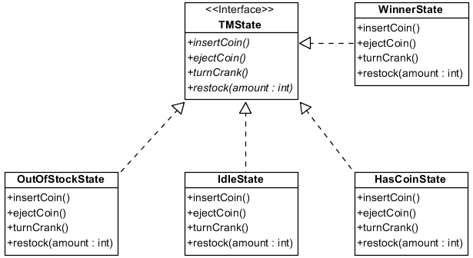
Now to Add the Winner State…
Lecture 3.1 Slide 22
Notes:
If that was all the benefits, its not bad. But this implementation really shines when changes are involved. For example, let’s now add the WinnerState class to the class diagram as we add the 10% lottery change. This is just a matter of creating a new WinnerState class that implements the TMState interface.

Slide 23
New State Machine
Lecture 3.1 Slide 23
Notes:
Here is the updated state machine diagram again. We have created a new Winner state, and we see that there is only one ingoing transition into Winner state, which is || this one, from Idle state. Therefore, the Idle state has to “know” about the Winner state as there may be a transition between the two states when insertCoin() is activated. On the other hand, none of the other states need to “know” about the Winner state, so their code is unaffected.

Slide 24
Changes to IdleState Class
class IdleState: TMState{
public void insertCoin() {
Console.WriteLine(“You inserted a coin.”);
// 10% chance
if ((myMachine.getWinner() == true) &&
(stock >= 2))
myMachine.setState(
myMachine.WinnerState);
else
myMachine.setState(
myMachine.HasCoinState);
}
// No other changes necessary
}
Lecture 3.1 Slide 24
Notes:
Let’s see how the insertCoin() method in the IdleState class is affected. Assuming that we have a method called getWinner that checks whether the 10% chance was hit, then the || code in red handles the case where the customer wins and there are at least 2 capsules in the machine, whereupon we go to WinnerState. Otherwise, we move to HasCoinState like before. No other changes are necessary.

Slide 25
WinnerState Class
class WinnerState: TMState {
// myMachine, constructor
public void insertCoin() {
Console.WriteLine(“You can’t insert another
coin!”);
}
public void ejectCoin() {
Console.WriteLine(“Coin returned.”);
myMachine.setState(myMachine.IdleState);
}
Lecture 3.1 Slide 25
Notes:
We now write the WinnerState class which is similar to all the other TMState classes that we have written. insertCoin() just produces an error message, and ejectCoin() transitions to Idle state.

Slide 26
WinnerState Class
public void turnCrank() {
dispense(2); // reduces stock by two
Console.WriteLine(“You win! Two for you!”);
if (stock > 0)
myMachine.setState(myMachine.IdleState);
else
myMachine.setState(
myMachine.OutOfStockState);
}
public void restock(int amount) {
Console.WriteLine(“You can’t restock while a
customer is buying a toy!”);
}
}
Lecture 3.1 Slide 26
Notes:
When turnCrank() is called, we call dispense() to dispense two capsules. We then check the stock value, if move to either Idle or OutOfStock state accordingly. Finally, restock() just prints an error message because you cannot restock if it is in the WINNER state.
And we’re done! All we needed to do was create a new Winner state and update the Idle state so that it transitions to the Winner state properly. None of the other states were affected, and we didn’t have to mess around with all those confusing if-else statements. Neat, right?

Slide 27
The State Pattern
Notes:
And that, ladies and gentlemen, was the State design pattern. Let’s summarize.

Slide 28
Definition
The State Pattern:
Allows an object to alter its behaviour when its internal state changes
The object will appear to change its class
Also known as
Objects for States
Lecture 3.1 Slide 28
Notes:
The State Pattern allows an object to alter its behavior when its internal state changes. The pattern encapsulates states into separate classes and assigns one such object to represent the current state. When a coin is inserted into our ToyMachine, it behaves differently depending on whether it is in IDLE state or HAS_COIN state. When you think about it, it’s almost as if an IDLE ToyMachine is a different class compared to a HAS_COIN ToyMachine, to the point where you could consider the object to have literally changed its class. Mind. Blown.
The State Pattern is also known as || Objects for States.

Slide 29
Applicability
An object's behavior depends on its state, and it must change its behavior at run-time depending on that state
Operations have large, multi-part conditional statements that depend on the state
Same conditional structure over many operations
State design pattern puts each branch in the conditional as a separate class
Each state is therefore an object and can vary independently
Lecture 3.1 Slide 29
Notes:
The state design pattern is applicable anytime a state machine is suitable. And you would model an object as a state machine when its behaviour depends on its state, and that behaviour might change during run-time. Additionally, how the object changes states might depend on somewhat complex multi-part if-else statements, and this structure applies across many operations. When these conditions apply, then using the || state design pattern will put each branch in the conditional, which is a state, into a separate class. This allows us to code and maintain each state independently.

Slide 30
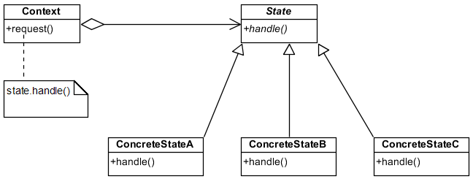
The State Pattern
Lecture 3.1 Slide 30
Notes:
Here is the general class diagram of the State Pattern. We have a Context, which is the class that can have a number of internal states. That’s our ToyMachine. The context will || contain an abstract object of type State, which we call TMState in our example, and this abstract class defines a number of abstract methods that handle() different situations. Since State is an abstract class, it will need to be specialized by concrete classes, such as IdleState, HasCoinState and WinnerState, who must therefore provide concrete implementations for the handle method. Note that even though this class diagram uses an abstract class and inheritance, we implemented this using an interface instead, which is just as valid. The most important factor is that when the Context requests that its state handles a situation, it simply calls state.handle(). Therefore, whichever is its current state, that version of handle() will be called accordingly.

Slide 31
Key Participants
The State defines an interface to encapsulate the behaviour of all states in the context
The ConcreteState implements the behaviour using the State interface
The Context
Is configured with State objects
Maintains an instance to a ConcreteState object that represents its current state
Lecture 3.1 Slide 31
Notes:
In summary, the || State defines a common interface for all the different ways the object can behave. If you want to be a Toy Machine state, you need to specify what you do when insertCoin() is called, or turnCrank(), etc.
The || ConcreteState implements the behaviour specified by the State interface, such as IdleState or HasCoinState.
The || Context class has a reference to a State object representing the current state, and this reference is assigned an object of type ConcreteState.

Slide 32
Summary
The State design pattern
Design Principle
Code to an interface, not an implementation
Lecture 3.1 Slide 32
Notes:
And that was the State design pattern. We followed the OO principle of coding to an interface instead of an implementation, and now you know how to implement state machines in a way that is easy to maintain, and hopefully you see the benefits of doing it in this way.
One design pattern down, lots more to go. That wasn’t so bad, right? We’re just getting started.

